Slide 1
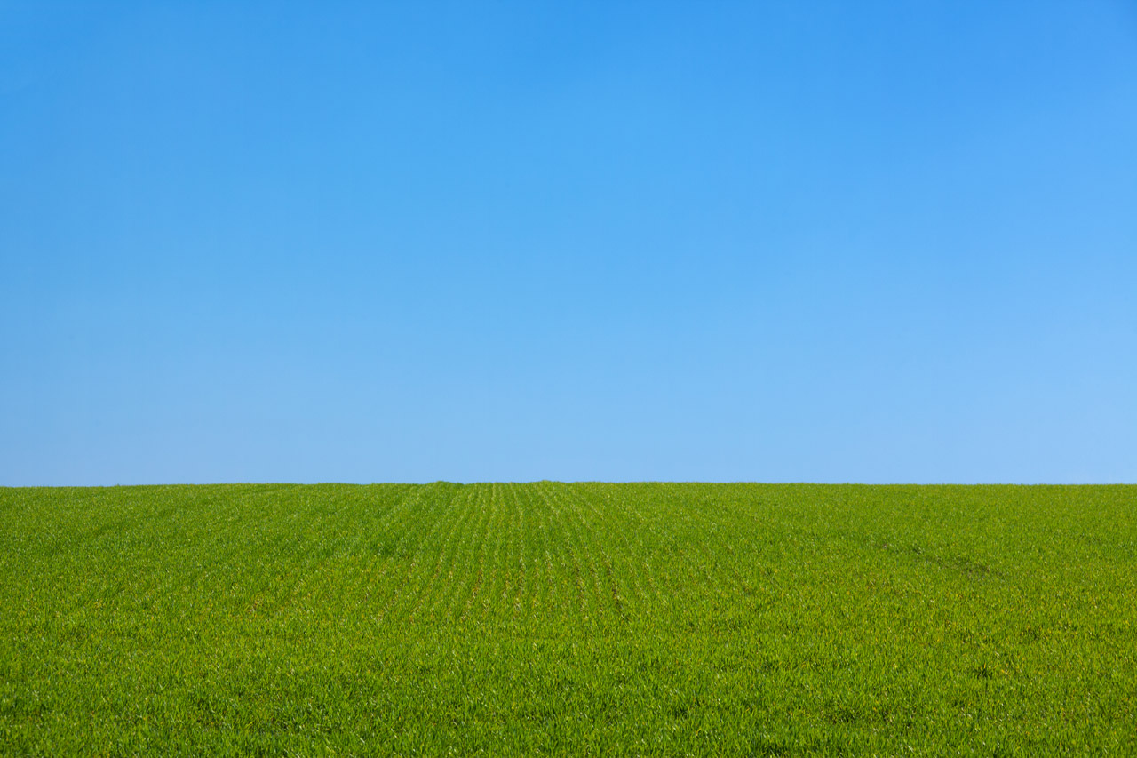
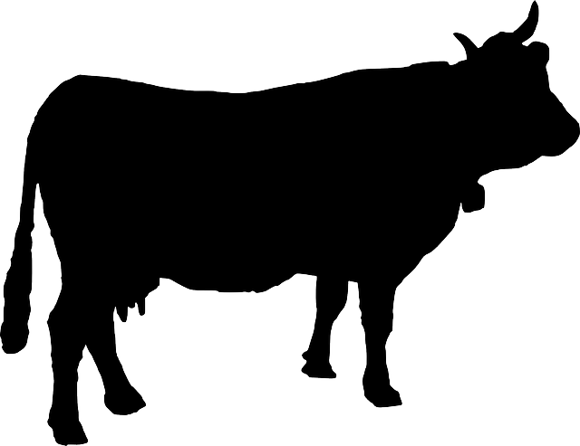
Our STEM Research Project
Robotics in
Dairy Farming

Slide 2
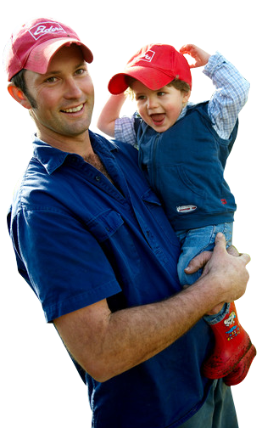
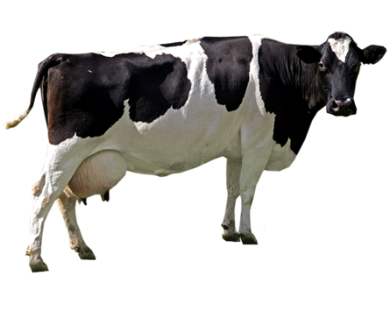
Dairy Farming in Ireland
Ireland is one of the world’s biggest milk producers.
Ireland has
Temperate climate
Grass growing ability
Dairying tradition

Slide 3
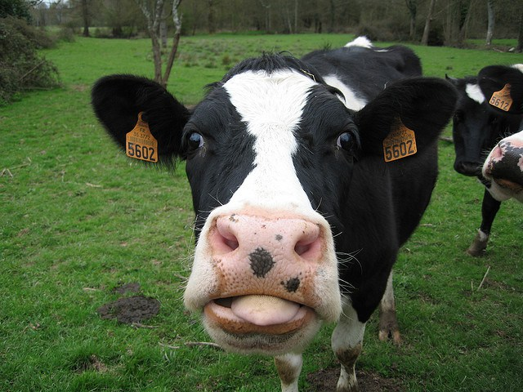
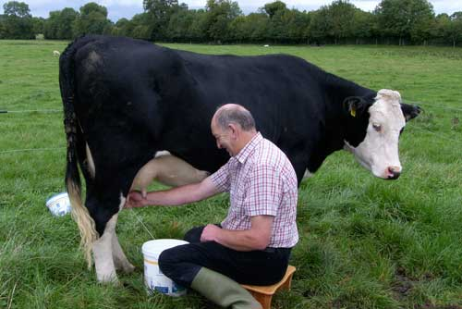
Milking by Hand
Cows were milked by hand twice a day
Difficult work
Time consuming
Farmers sat on a low stool
Milk was collected in a bucket

Slide 4
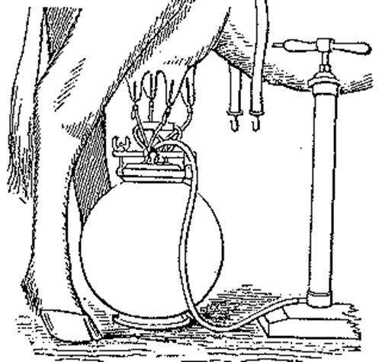
Early Milking Machines
First successful milking machine introduced as early as 1870
Brutal
Tubes inserted, teats forced open
Increased infection risk for cows

Slide 5
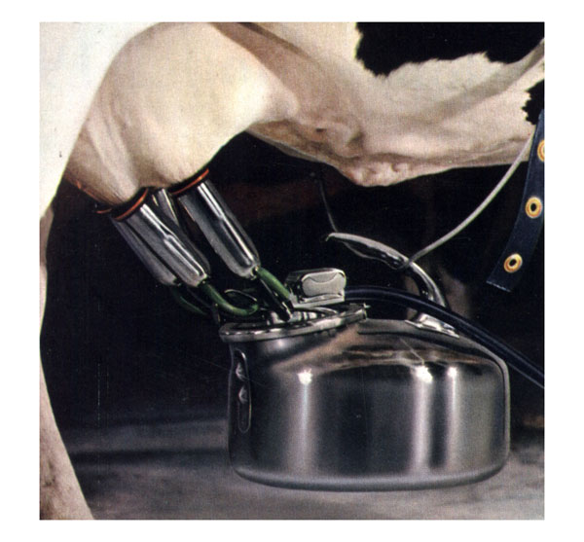
Advances in Milking Machines
Surge Milker – Herbert McCornack, 1922
Pulsating tug and pull movement – similar to a calf
Easy to clean and sanitise

Slide 6
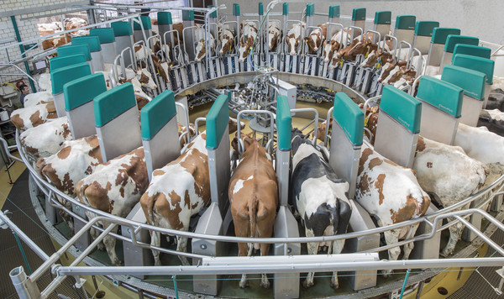
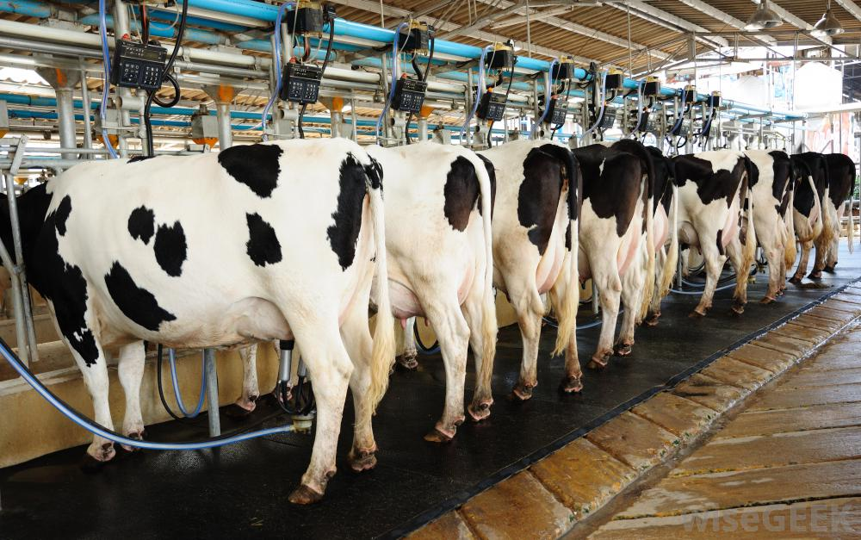
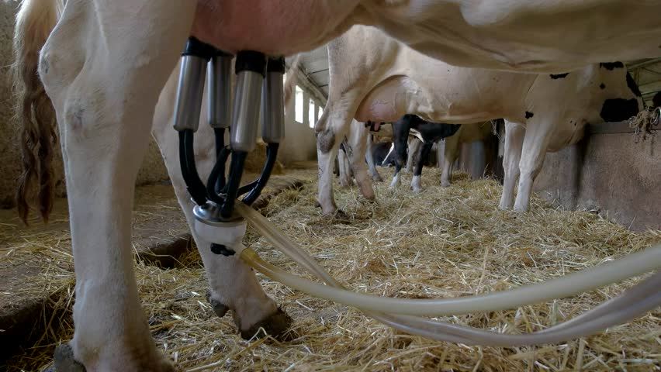
Modern Milking Machines
Completely closed pipeline
Teat cups attached to cow’s udder –
milk line goes directly to bulk tank
Parallel, herringbone and rotary parlour designs
Efficienct

Slide 7
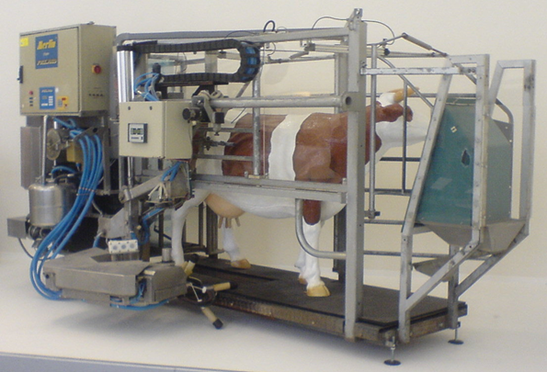
Robotic Milking Parlour (AMS)
Growing number of farmers using AMS
Milks cows automatically – no need for humans to be present
Cows choose when to enter the robot to be milked

Slide 8
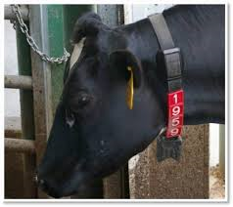
How Does A Robotic Milking Machine Work?
The robot recognises my tag number and then knows the shape of my body and udders.
It even knows when I was last milked.
If I go in too close to my last milking time the gate will open and I go out again!

Slide 9
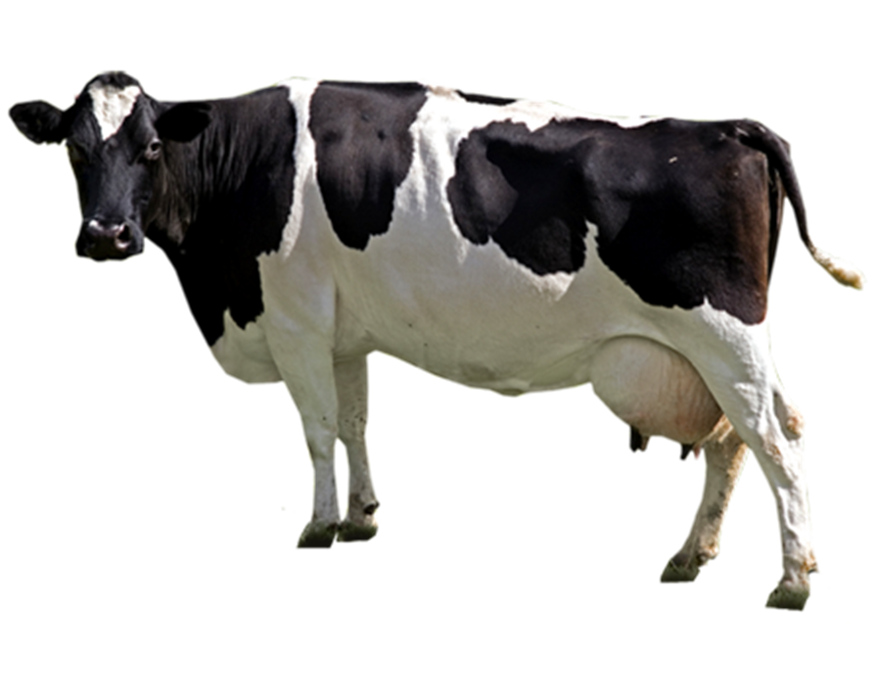
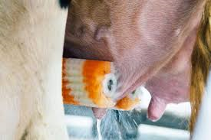
Next, a robotic arm with a spinning orange and white brush extends and gently rolls along the underside of my belly.

Slide 10
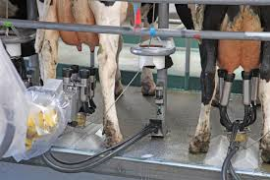
After that, an arm holding 4 plastic tubes attached to a transparent tank comes out, and lasers help the tubes to be placed onto my teats one by one!

Slide 11
Tubes that function as little vacuums suck out my milk at a rate customised to my own production!

Slide 12
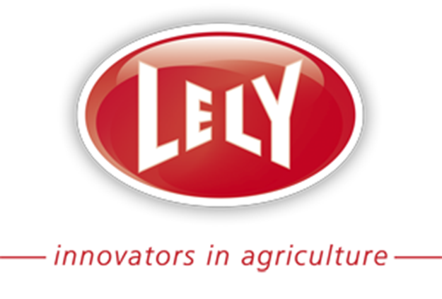
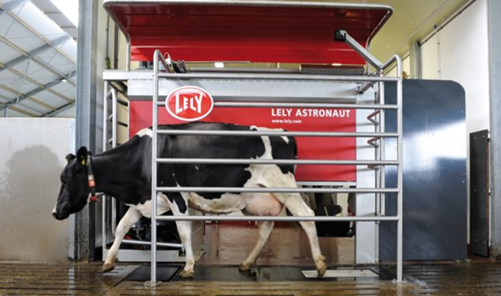
Lely Robotic Milking at the National Ploughing Championships
Enjoy a brief video!

Slide 14
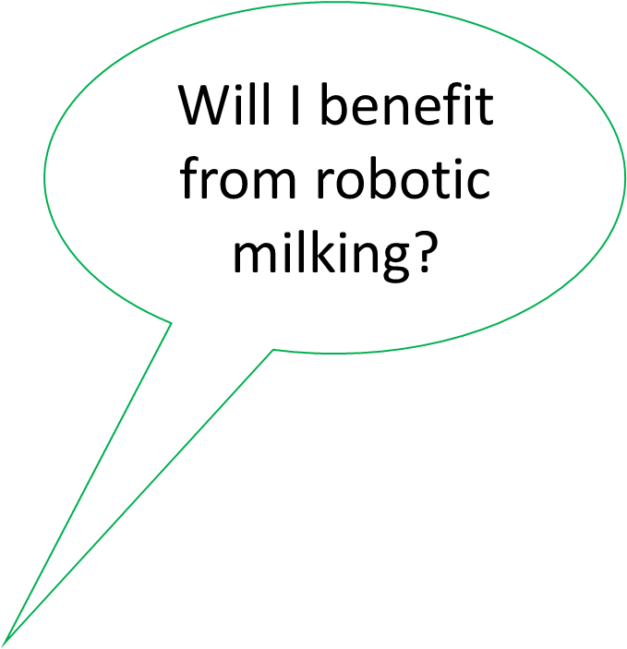
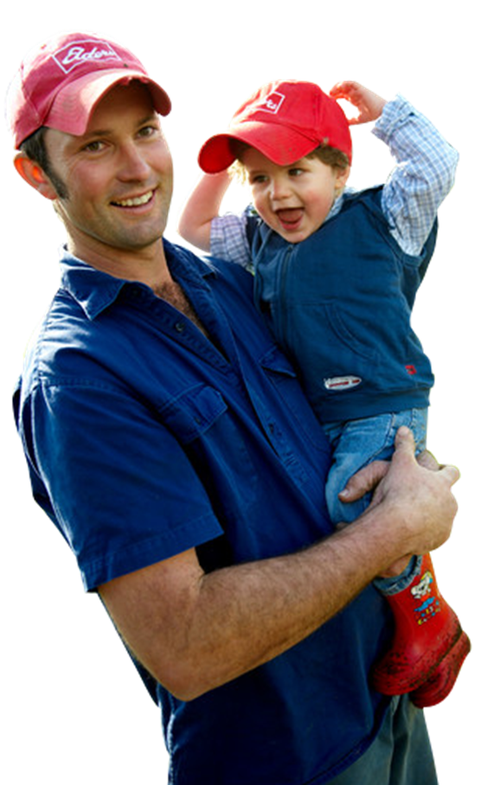
What are the benefits for the farmer?
Farmer not tied to morning & evening milking
More time to spend with family
More time to manage cows’ health
Cell count readings for every cow at every milking
Increased milk production
24-hour robot specialist back-up provided

Slide 15
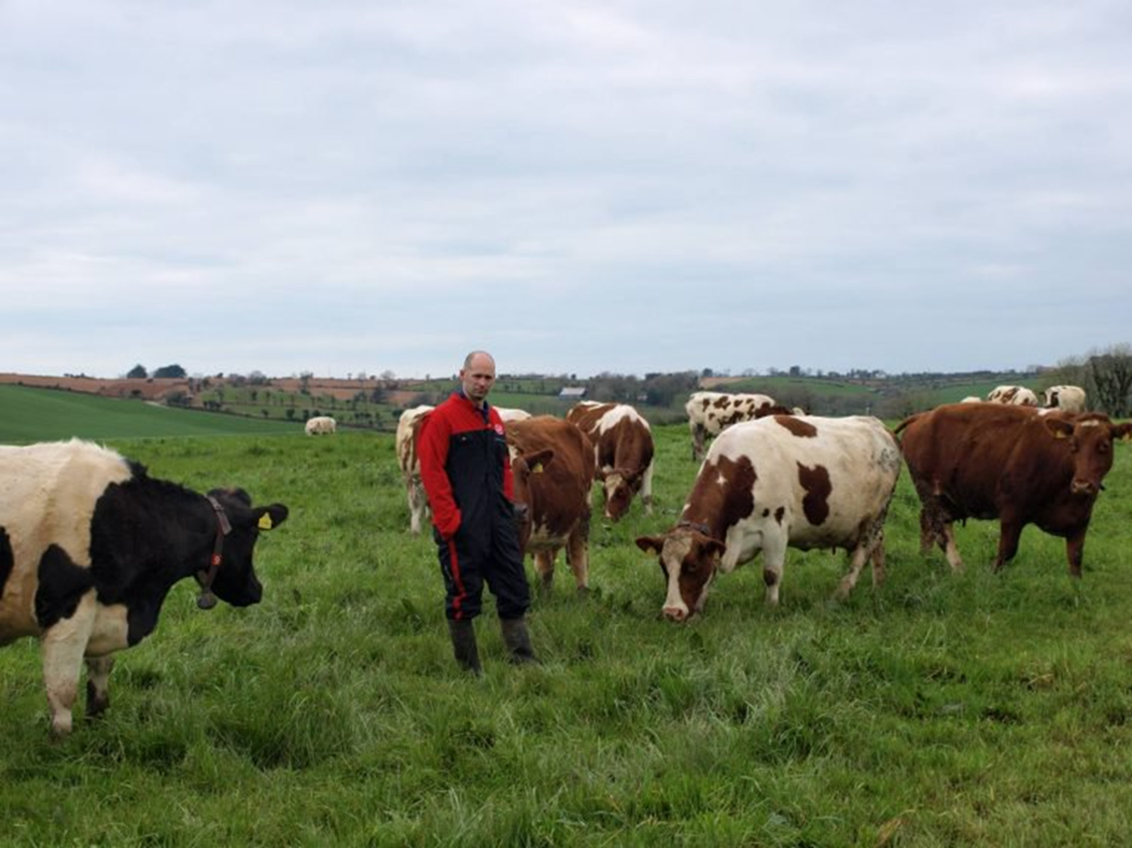
‘My wife is happier that she is seeing more of me and I am not tied to morning and evening milking’
Stephen Harte, Cork

Slide 16
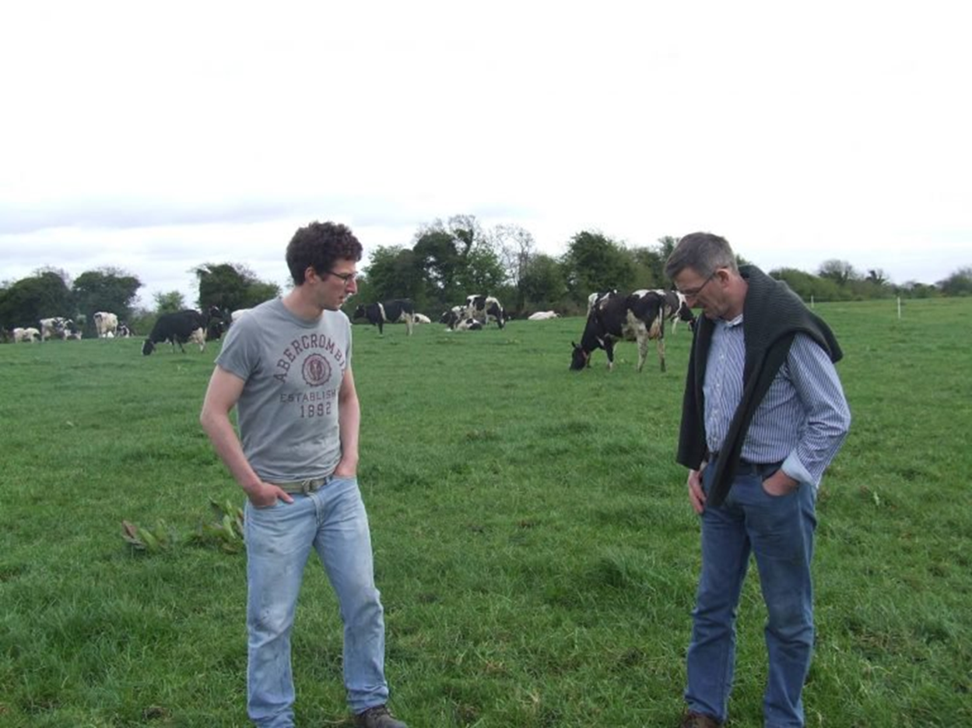
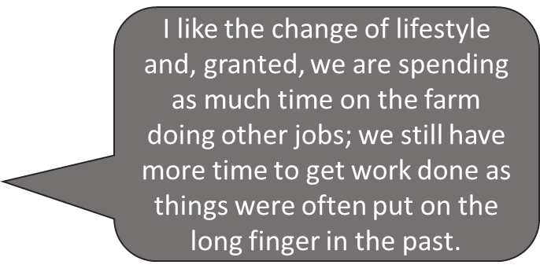
“The great thing is the flexibility in the evenings, as we are not tied to milking cows anymore so we can come and go as we please,” said Louis

Slide 17
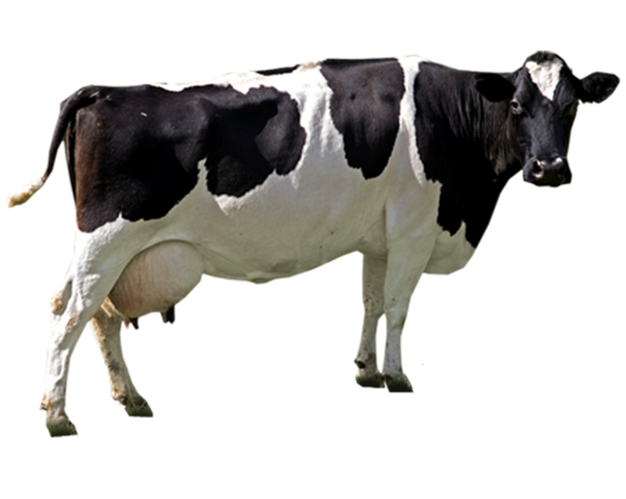
Yes!
You will experience many benefits such as improved health, increased production and better reproduction performance.
Will I benefit from robotic milking?

Slide 18
Of course, you will not be harmed in any way! You will be more settled and happier. Your farmer will be more relaxed and will have more time to concentrate on your health!
Is robotic milking ethical?

Slide 19
AMS Impacts on Cow Health and Welfare
I am a happy free range cow!
I choose when to be milked, I am not forced into milking twice a day.
A robot will never take over from my farmer!
The robot give the farmer lots of information which help him to look after me!

Slide 20
Is Robotic Milking the future for Irish Dairy Farming?
Growing numbers of farmers moving towards robotic milking
Less stress for farmers
90% of cows adapt quickly to robotic milking
Incentive for young people
Robots don’t get tired

Slide 21
It is envisaged that 20% of cows in the
EU will be milked
automatically by 2020
~Teagasc~
Will all cows be milked by robots when I am a farmer?

Slide 22
Thank You
From
Team Clobot!!

